Slide 1
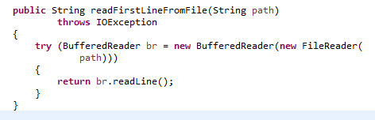
The try-with-resources Statement
The try-with-resources statement is a try statement that declares one or more resources.
A resource is an object that must be closed after the program is finished with it.
The try-with-resources statement ensures that each resource is closed at the end of the statement.
Any object that implements java.lang.AutoCloseable, which includes all objects which implement java.io.Closeable, can be used as a resource.
This example reads the first line from a file. It uses an instance of BufferedReader to read data from the file. BufferedReader is a resource that must be closed after the program is finished with it.
In this example, the resource declared in the try-with-resources statement is a BufferedReader. The declaration statement appears within parentheses immediately after the try keyword. The class BufferedReader, in Java SE 7 and later, implements the interface java.lang.AutoCloseable. Because the BufferedReader instance is declared in a try-with-resource statement, it will be closed regardless of whether the try statement completes normally or abruptly (as a result of the method BufferedReader.readLine throwing an IOException).

Slide 2
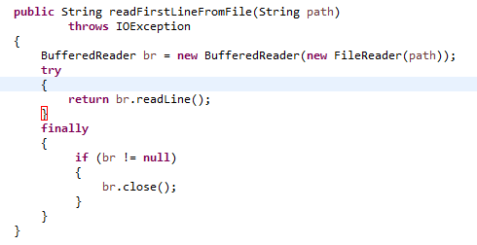
The try-with-resources Statement
Prior to Java SE 7, you can use a finally block to ensure that a resource is closed regardless of whether the try statement completes normally or abruptly. This example uses a finally block instead of a try-with-resources statement:

